Slide 1

Homework 5 (Due: 4/13 )
(1) Create an image consisting of a white square with
a black background, e.g.,
(2) Rotate the image by 30 degrees. Use (a) rotation
with neighbor interpolation, and (b) rotation with
bilinear interpolation.
(3) Compare the two results.

Slide 3
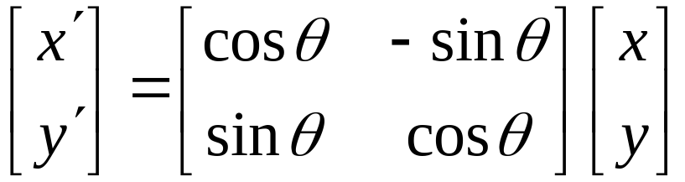
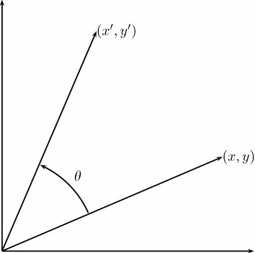
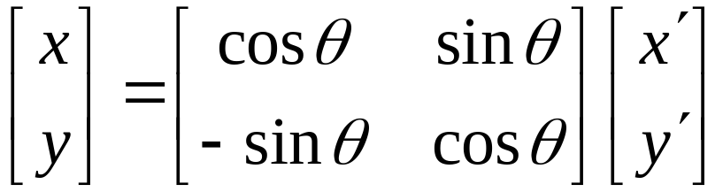
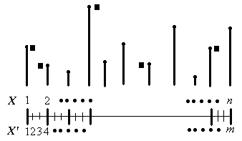
Image Rotation
Nearest Neighbor Interpolation
2-<number>

Slide 4
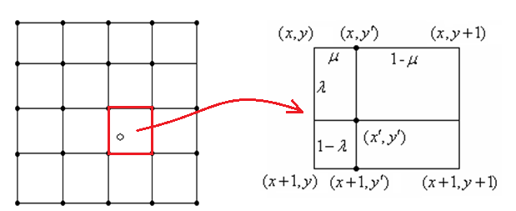
Bilinear Interpolation
2-<number>

Slide 5
Bilinear Interpolation
(x_org_floor, y_org_ceil)
(x_org_ceil, y_org_ceil)
u
1-u
v
(x_org, y_org)
1-v
(x_org_floor, y_org_floor)
(x_org_ceil, y_org_floor)
2-<number>

Slide 6









Bilinear Interpolation
2-<number>

